Slide 1
Male Reproductive Organs in Domestic Animals

Slide 2
The male reproductive system of farm mammals consists of:
Two testes (testicles).
Duct system.
Accessory organs: glands and the penis.

Slide 3
SCROTUM
The scrotum is a cutaneous (skin) sac;. A layer of fibro-elastic tissue mixed with smooth muscle fibers called tunica dartos.
The scrotum provides the favorable environment of a lower temperature for the reproduction of spermatozoa.
The scrotum consists of five layers from outside to inside as follows:

Slide 4
Outer layer (the skin or epidermis).
Tunica dartos
Stratum subdarticum
Parietal tunica vaginalis
Visceral tunica vaginalis

Slide 5
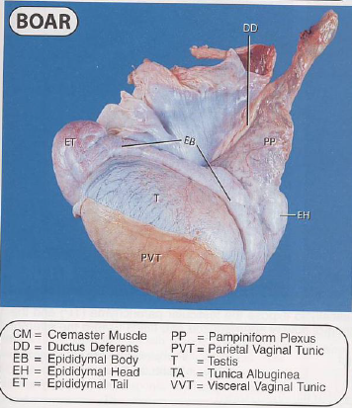

Slide 6
TESTES
The tests (testicles) vary somewhat from species to species as far as shape, size, and location are concerned, but the essential structure is the same. Each testis consists of a mass of seminiferous tubules surrounded by a heavy fibrous capsule called the tunica albuginea. A number of fibrous septa, or trabeculae, pass inward from the tunica albuginea to form a framework or stroma for support of the seminiferous tubules.

Slide 7
The tests temperature to make its function properly should be less than body temperature (2-4c◦). these temperature regulate by:
Muscles of scrotum.
Muscles which cover the spermatic cord.
Circulating blood in the spermatic cord.

Slide 8
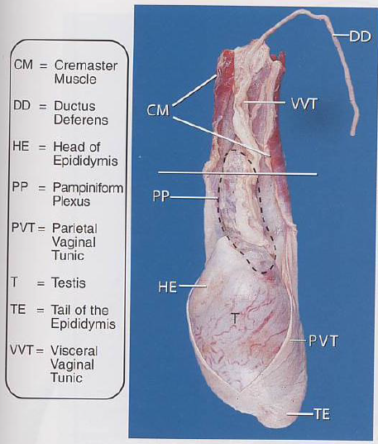

Slide 9
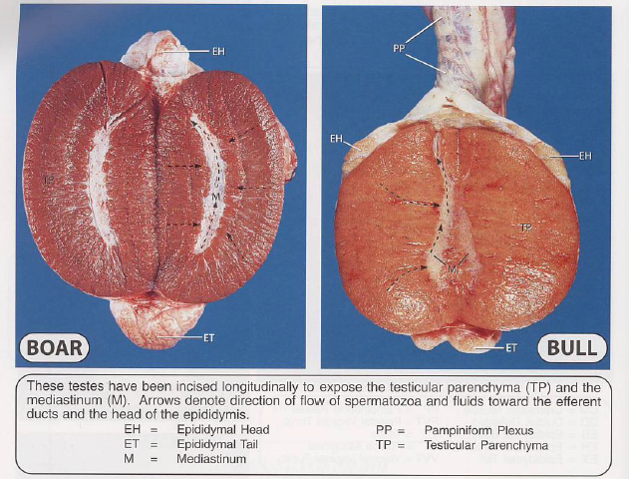

Slide 10
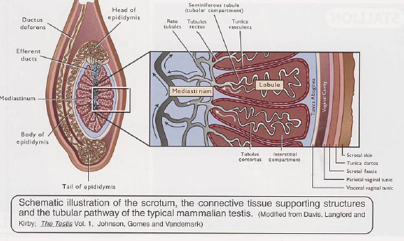

Slide 11
EPIDIDYMIS
The epididymis is a very long convoluted tube which connects the vasa efferentia of the testis with the vas deference or ductus deferens.
(33-35 m in bull, 50 m in boar, 6 m in man).
The head of the epididymis attaches to the same end of testis that the blood vessels and nerves enter.

Slide 12
The body of the epididymis parallels the long axis of the testis, and the tail of the epididymis continues as the ductus deferens, which doubles back along the body of the epididymis to the region of the head, where it enters the spermatic cord
The epididymis serves as a place for spermatozoa to mature prior to the time they are expelled by ejaculation.

Slide 13
DUCTUS DEFERENS
The ductus deferens (vas deferens) is a muscular tube which, at the time of ejaculation, propels the spermatozoa from the epididymis to the ejaculatory duct in the prostatic urethra, its long about 45 cm.

Slide 14
SPERMATIC CORD
As the testis descends from the region caudal to the kidney, it brings with it the same blood, nerve and lymphatic supply present in the embryo. These structures, the testicular vessels and nerves, make up a large part of the spermatic cord which connects the testis with the rest of the body. The spermatic cord also includes the ductus deferens, which connects the tail of the epididymis with the prostatic urethra.

Slide 15
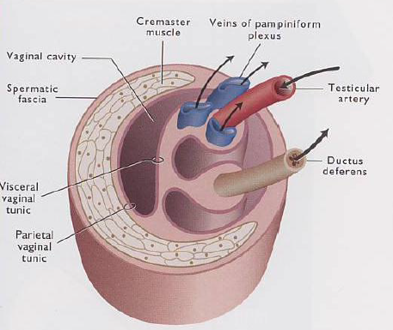

Slide 16
INGUINAL CANAL
The inguinal canal is a passage from the abdominal cavity to the exterior that extends from the internal inguinal ring to the external inguinal ring. The inguinal canal is potentially very extensive; it normally is only large enough to permit passage of the spermatic cord and inguinal vessels and nerves

Slide 17
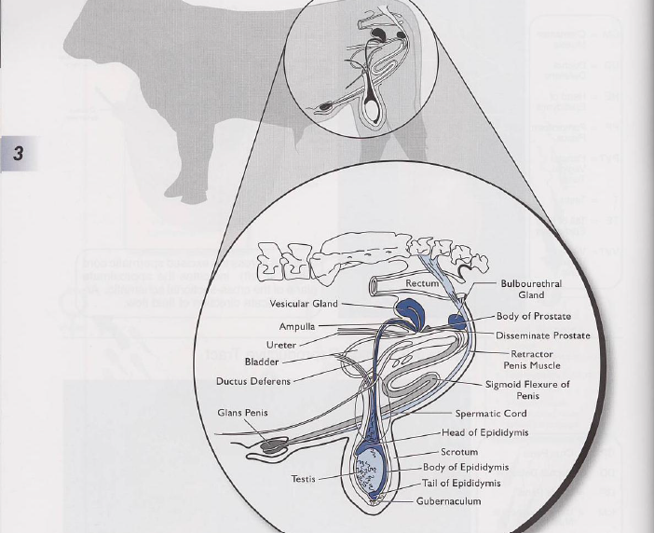

Slide 18
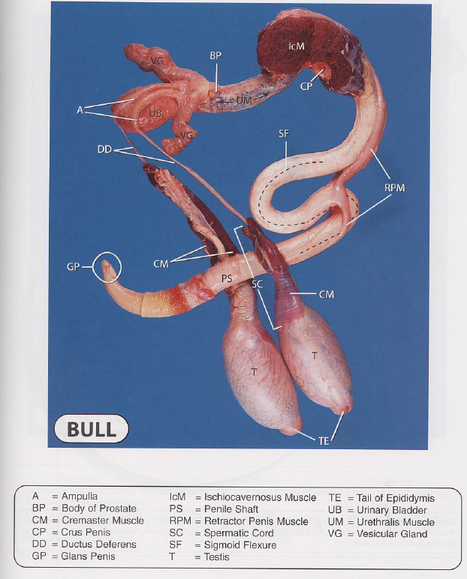

Slide 19
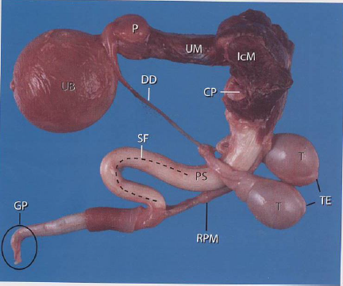

Slide 20
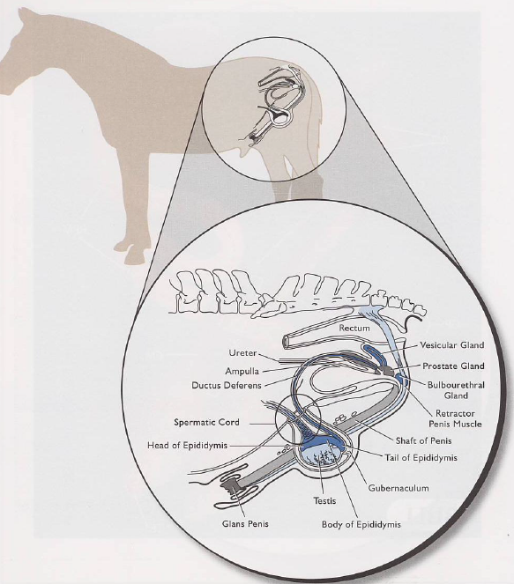

Slide 21
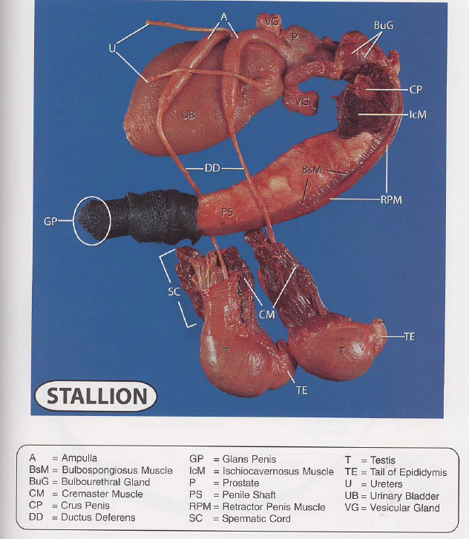

Slide 22
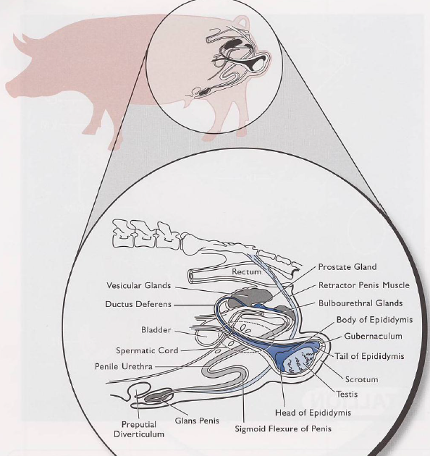

Slide 23
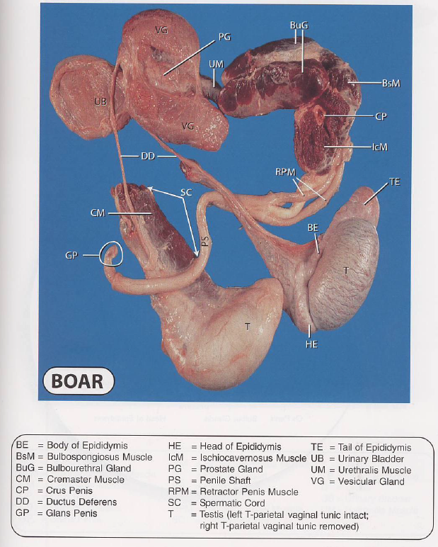

Slide 24
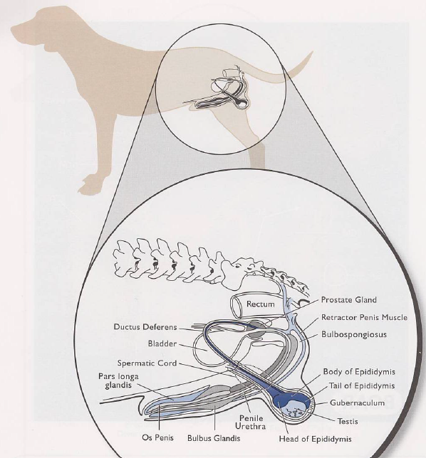

Slide 25
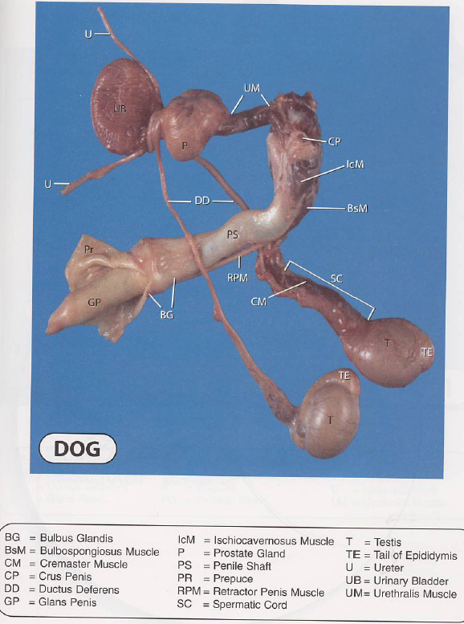

Slide 26
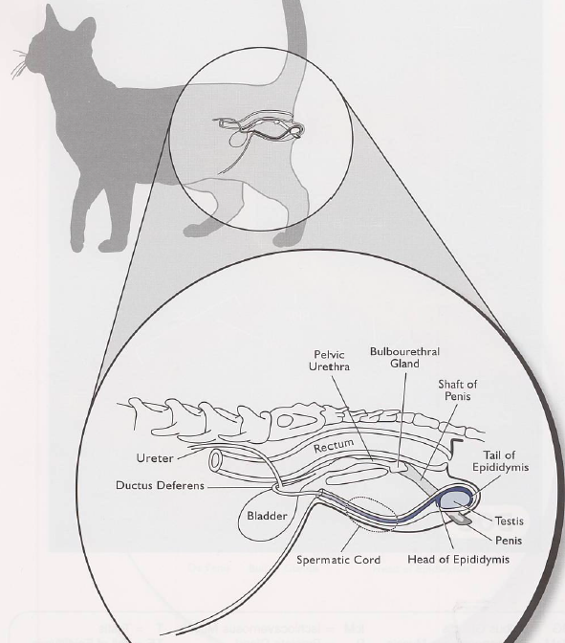

Slide 27
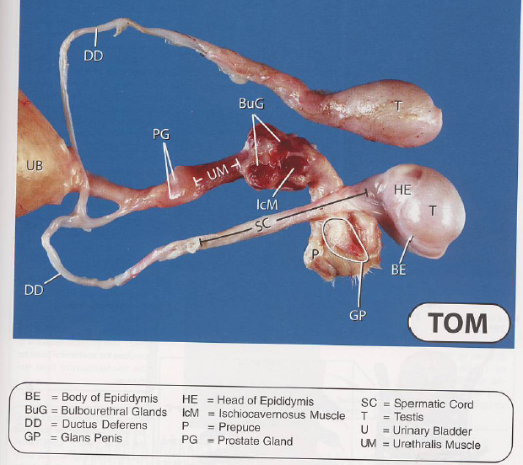

Slide 28
ACCESSORY SEX GLANDS

Slide 29
AMPULLA
SEMINAL VESICLES (vesicular glands)
PROSTATE GLAND
BULBO-URETHRAL GLANDS (Cowper's glands)

Slide 30
Species | Prostate | Seminal Vesicles | Bulbo-Urethral | Ampulla
Horse | + | + | + | +
Ruminants | + | + | + | +
Alpaca | + | + | + | +
Pig | + | + | + | -
Dog | + | - | - | +
Cat | + | - | + | -

Slide 31
Position of accessory glands

Slide 32
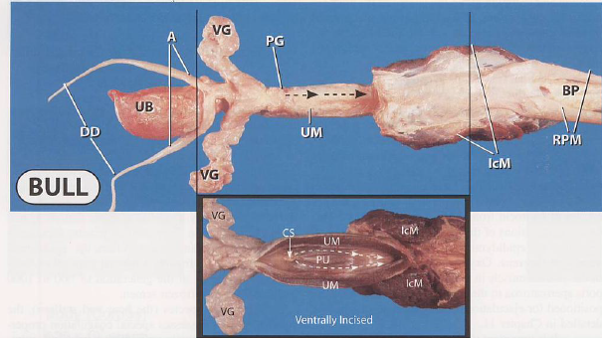

Slide 33
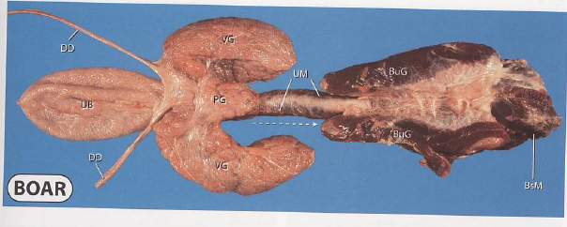

Slide 34
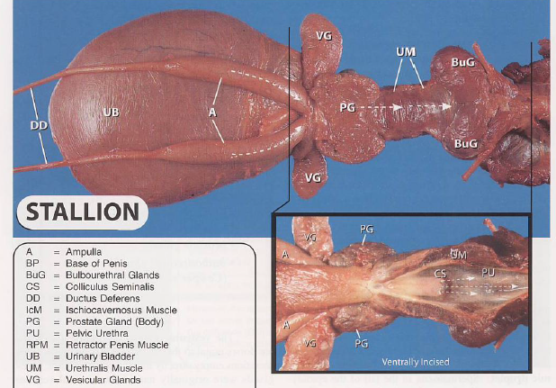

Slide 35
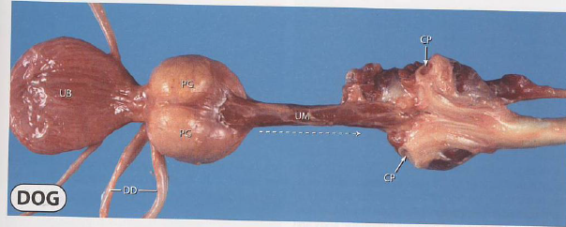

Slide 36
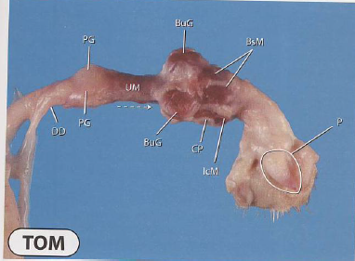

Slide 37
Penis copulation organ

Slide 38
PENIS
The penis is the male organ of copulation which is composed essentially of erectile tissue. It is long, cylindrical with a very much smaller in diameter. Sigmoid flexure just behind the scrotum, it forms an S-shaped curve, and its position is affected during erection.
The penis presents three main parts:
ROOT: it is attached to the lateral parts of the ischial tuberosity.
BODY: it constitutes the bulk of the organ.
GLANS PENIS: it is the terminal part and free end of the organ.

Slide 39
PREPUCE
The prepuce (or sheath) is an invaginated fold of skin surrounding the free extremity of the penis. The outer surface is fairly typical skin, while the inner mucous membrane consists of a preputial layer lining the prepuce and a penile layer covering the surface of the free extremity of the penis.

Slide 40
MALE URETHRA
The male urethra is a long mucous tube which extends from the urinary bladder to the glans penis. The urethra lies in a groove on the ventral surface of the corpus cavernosum penis muscle. The urethra passes caudally on the floor of the pelvis, turns around the ischial arch, forming a sharp bend, and passes forward as a part of the penis, enclosed in the corpus cavernosum urethra.

Slide 41
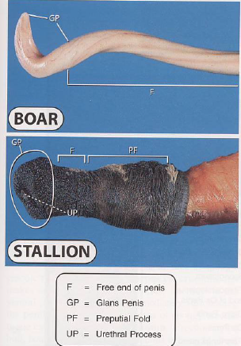

Slide 42
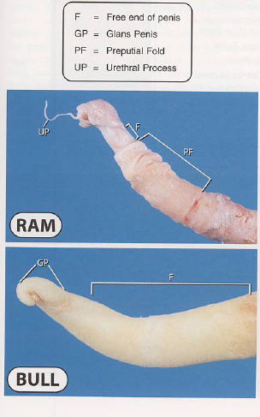

Slide 43
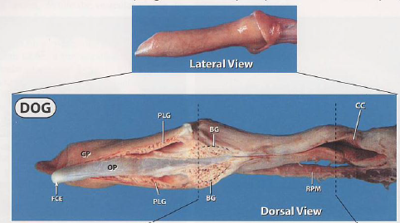
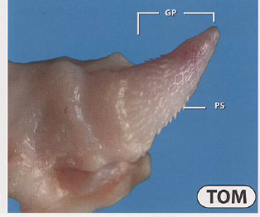

Slide 44
thanks

